Slide 1
Eta Sigma Delta
International Hospitality Honor Society
ESD Faculty Advisor’s
Town Hall Meeting
Hosted by: Ruth O’Rourke,
ESD Chair of Board of Governors Wednesday, November 17, 2021

Slide 2
AGENDA
ICHRIE Values
6 Points of Honor
Diversity-Equity-Inclusion
2021-2022 Service Learning Theme
NEW ESD Student Benefits
ICHRIE Membership
NEW Online Processes
Induction Ceremony
Faculty Advisor
Student Application

Slide 3
INTERNATIONAL COUNCIL OF HOTEL, RESTAURANT, INSTITUTIONAL, EDUCATION (ICHRIE)
http://www.ichrie.org/
ICHRIE is the professional association for international hospitality and tourism education within higher education institutions. Eta Sigma Delta is hosted under. ICHRIE, our parent association.
ICHRIE Values:
Spirit of Hospitality: We believe in hospitality as the key to overcome challenges in order to provide our members an unrivalled, personalized service.
Knowledge: We believe education and research serve as conduits that bind the global community.
Participation & Collaboration: We continuously evolve as professionals through research discovery, experiences, information sharing and collaborations
Inclusiveness: We respect people, value diversity, and are committed to equality for everyone.
Within the ICHRIE Bylaws Article XVII, here is the newly approved as of August 2020:
DIVERSITY AND INCLUSION As a global association dedicated to supporting and furthering hospitality and tourism education and research, ICHRIE is committed to ensuring a diverse, inclusive, and equitable environment where all members, employees, and volunteers, whatever their gender, gender identity, race, religion, ethnicity, national origin, age, sexual orientation, sexual identity, education or disability, feels valued and respected. ICHRIE is committed to a nondiscriminatory approach by providing equal opportunity for membership, participation, and leadership opportunities in all aspects of the association’s activities. ICHRIE will respect and value diverse life experiences and heritages and will seek to ensure that all voices are valued and heard.

Slide 4
Service Learning Theme 2021-2022
Our Purpose -
ESD is committed to ensuring a diverse, equitable, and inclusive environment where all student members, alumni, and faculty advisors, whatever gender identity, race, religion, ethnicity, national origin, age, sexual orientation and identity, education, or disability feel valued and respected. ESD is committed to a nondiscriminatory approach by providing equal opportunity for membership, participation, and leadership opportunities in all aspects of the honor society. ESD will respect and value diverse life experiences and cultures and will seek to ensure that all voices are valued and heard. We recognize that diversity- equity-inclusion is a continuous conversation and will be embedded within all points of honor, student activities and professional development.

Slide 5
6 Points of Honor
Creativity
Diversity-Equity-Inclusion
Ethics
Excellence
Leadership
Service

Slide 6
ICHRIE Membership for ESD Students
ICHRIE ESD Student Membership
A Student Member of ICHRIE is an undergraduate whose membership is provided through their induction into an Eta Sigma Delta Chapter. The individual will be a student member for the totality of their undergraduate career. A Student Member of ICHRIE will be entitled to specific benefits as stated and will need the organisations email address to qualify. They are not able to vote in ICHRIE or Federation elections, nor stand for any position within ICHRIE. On successful graduation ESD student members will be eligible for Associate Membership of ICHRIE free of charge until the 31st December of that year.
https://www.chrie.org/membership-categories

Slide 7
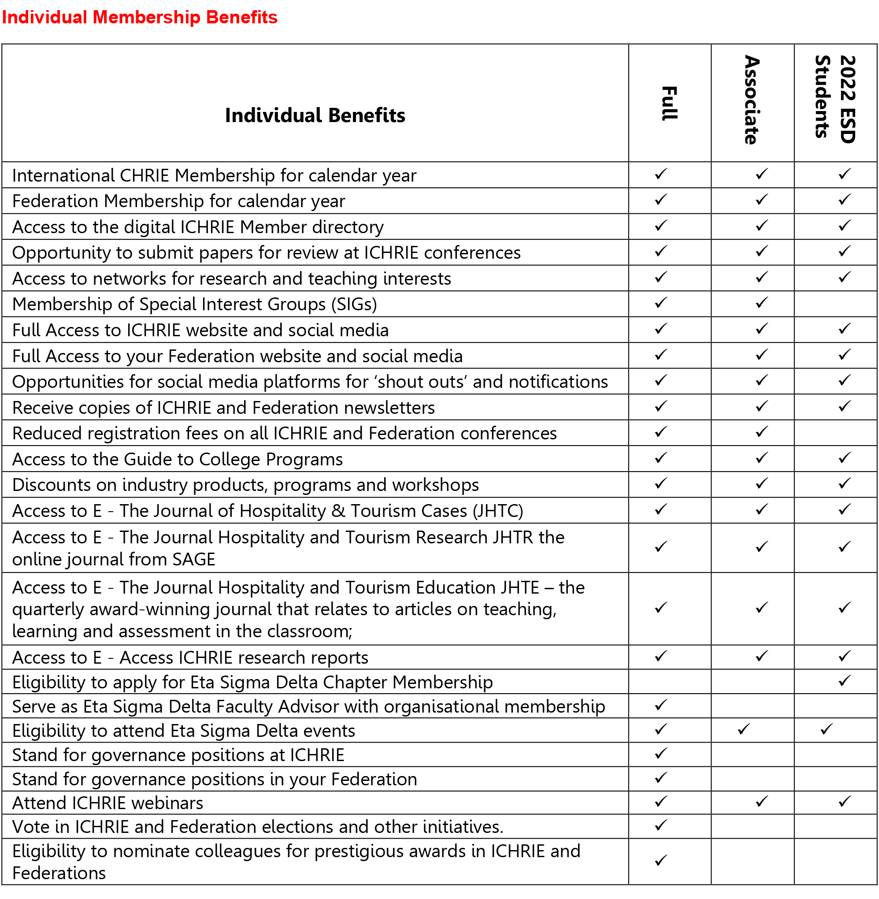
ESD Member Benefits

Slide 8
What About our Fall 2021 Inductees
All qualified Fall 2021 ESD inductees will become ICHRIE members in January 2022

Slide 9
What Is NEW Starting January 2022?
Spring Semester 2022 (from January 2022 onward)
For all the inductions starting Spring 2022 the following new operating system will apply:
ESD Advisor will go online to chrie.org/ESD downlink/ESD Induction/ESD Advisor Induction to fill out and submit their school ESD Induction information
NEW TIMELINE: ESD Advisors will need to provide at least a 5-week in advance notice to ICHRIE headquarters of their induction ceremony plan/date. This is to allow time for the students to go into the ICHRIE website and fill out their membership application and submit electronically the application and their application fee of $35.00

Slide 10
What Is NEW Starting January 2022? continued…
ESD Advisor in their notification to ESD honor society acceptance to student will both congratulate and announce to the student their acceptance and their need within 2 weeks to go online to chrie.org/ESD downlink/ESD Student Induction to fill out and submit their membership form with their $35.00 payment. They will need to open an account with ICHRIE as a new member by providing their email address, and setting up a password. This will open when they click on the ESD Student Induction link. This payment is preferably made by credit card, but could be based on policy, alternatively paid by the school if checked by the ESD Advisor on the ESD Advisor form, or be an individual ESD student check to ICHRIE sent to the ICHRIE office to attention Shaina Williams, ICHRIE 2810 N. Parham Road, Suite 230, Richmond, Virginia 23294
ICHRIE office will process electronically all the incoming ESD members

Slide 11
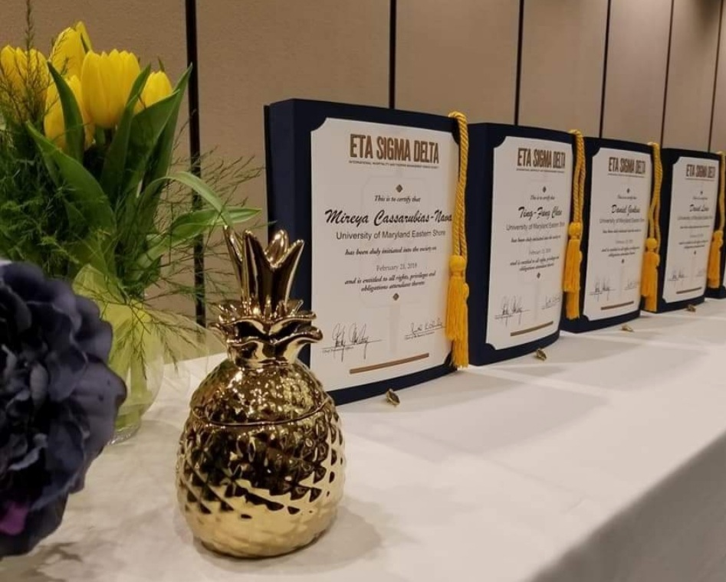
ESD Section of the “new” ICHRIE website Starting January 2022
?

Slide 12
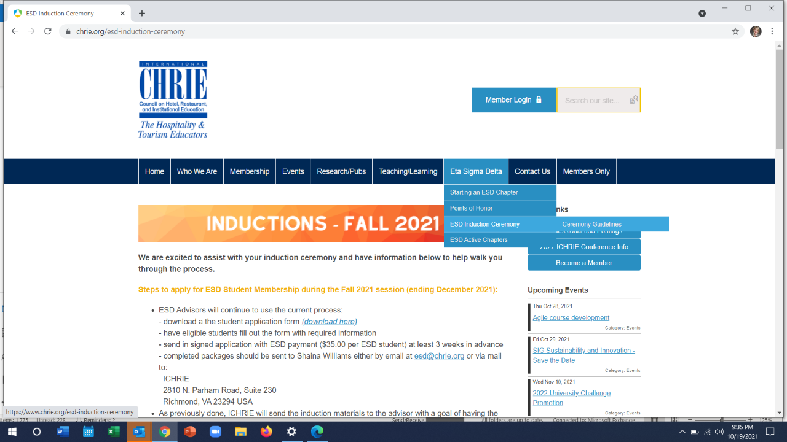
ESD Section of the “new” ICHRIE website Starting January 2022
?

Slide 13
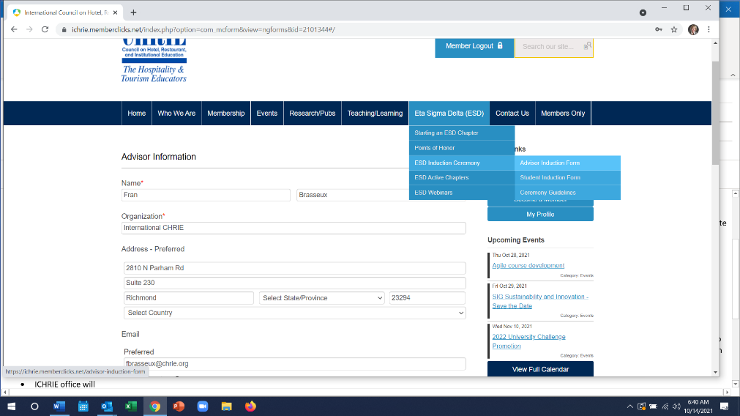
Advisor Information Form
To access the forms, member user name and password must be inserted to gain access. One the first visit to the new website, member must input their user name (normally email address) & reset their password, receive a link in their email and reset their password. Then advisor induction form should be filled out and submitted electronically 5 weeks before planned induction ceremony

Slide 14
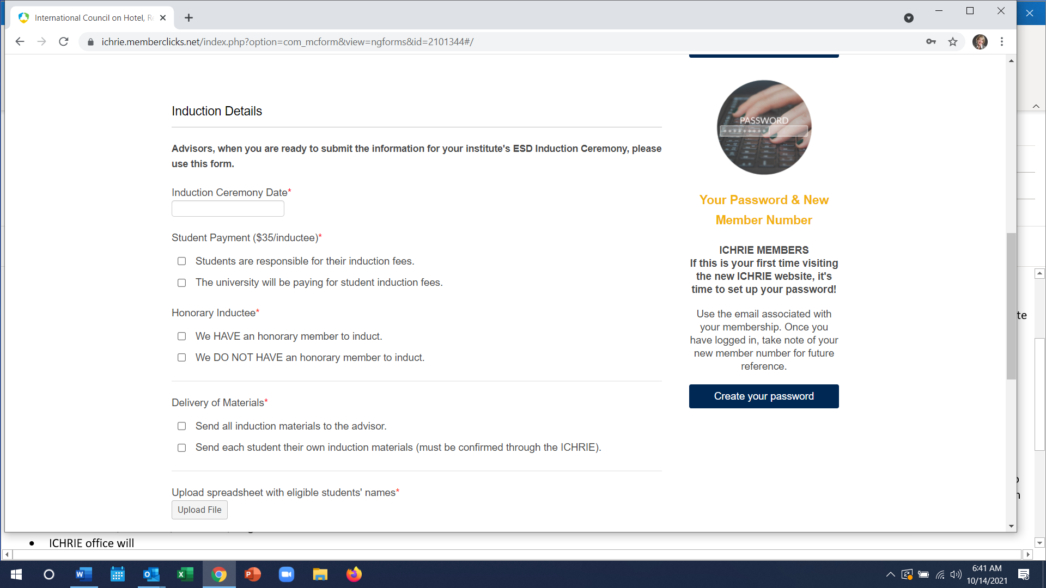
Advisor Information Form

Slide 15
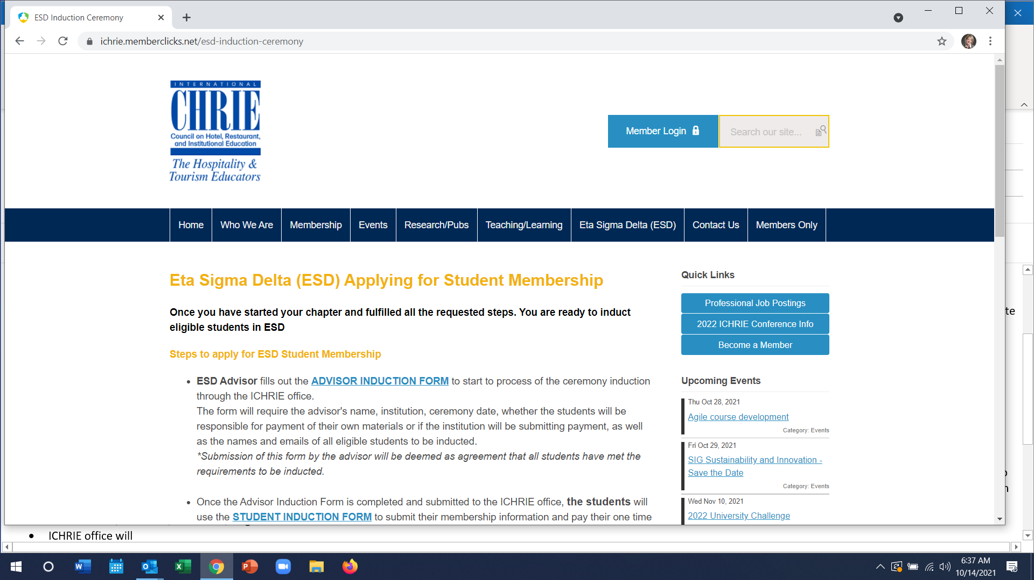
Student Membership Forms

Slide 16
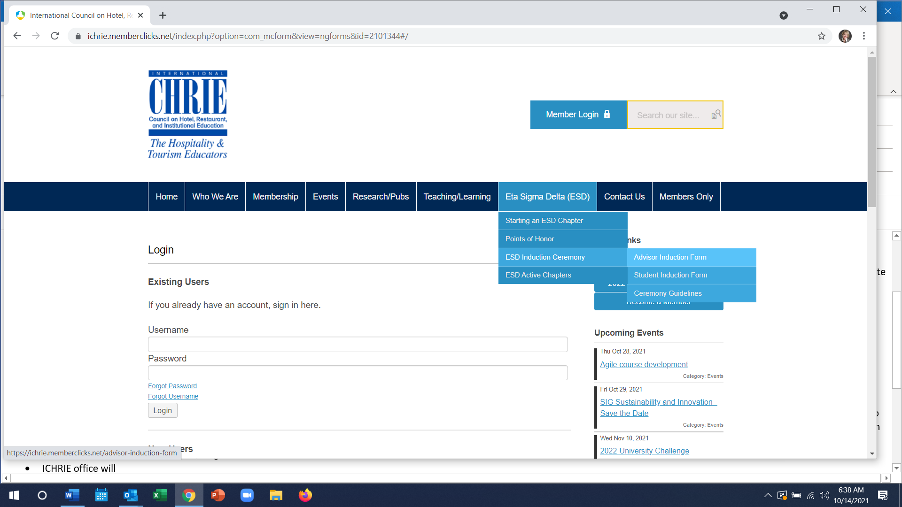
Student Membership Forms

Slide 17
NEXT STEPS….
Follow up email to all ESD faculty advisors with today’s Zoom recording and Powerpoint
2nd Town hall Meeting to be held on Monday, December 6, 2021 at 3pm (EST)
Email letter to be sent early January to all ESD faculty advisors outlining the process
NEW marketing flyer out lining all ESD ICHRIE benefits

Slide 18
Questions?

Slide 20
Eta Sigma Delta Board of Governors
Dr. Donna Albano, Stockton University and Treasurer
Fran Brasseux, Executive Director of ICHRIE
Milena Kuznin, RIT University – Croatia and ESD BOG member
Tim Flohr, University of Memphis and Secretary
Dr. Daniel Leung, Hong Kong Poly Technical University and APacCHRIE Representative
Dr. Jeff Lolli, Widener University and NENA Federation Representative
Dr. Godwin Obgeide, Purdue Northwest University and Director of Marketing
Ruth O’Rourke, James Madison University and ESD Chair of Board of Governors
Dr. Stacey Smith, Fort Hayes State University and Director of Professional Development
Dr. Willie Tao, Oklahoma State University and CentralCHRIE Federation Representative
Dr. Andrea White-McNeil, Bethune-Cookman University and SESCA Federation Representative
Dr. Han Wen, University of North Texas and West Federation Representative

